Slide 1
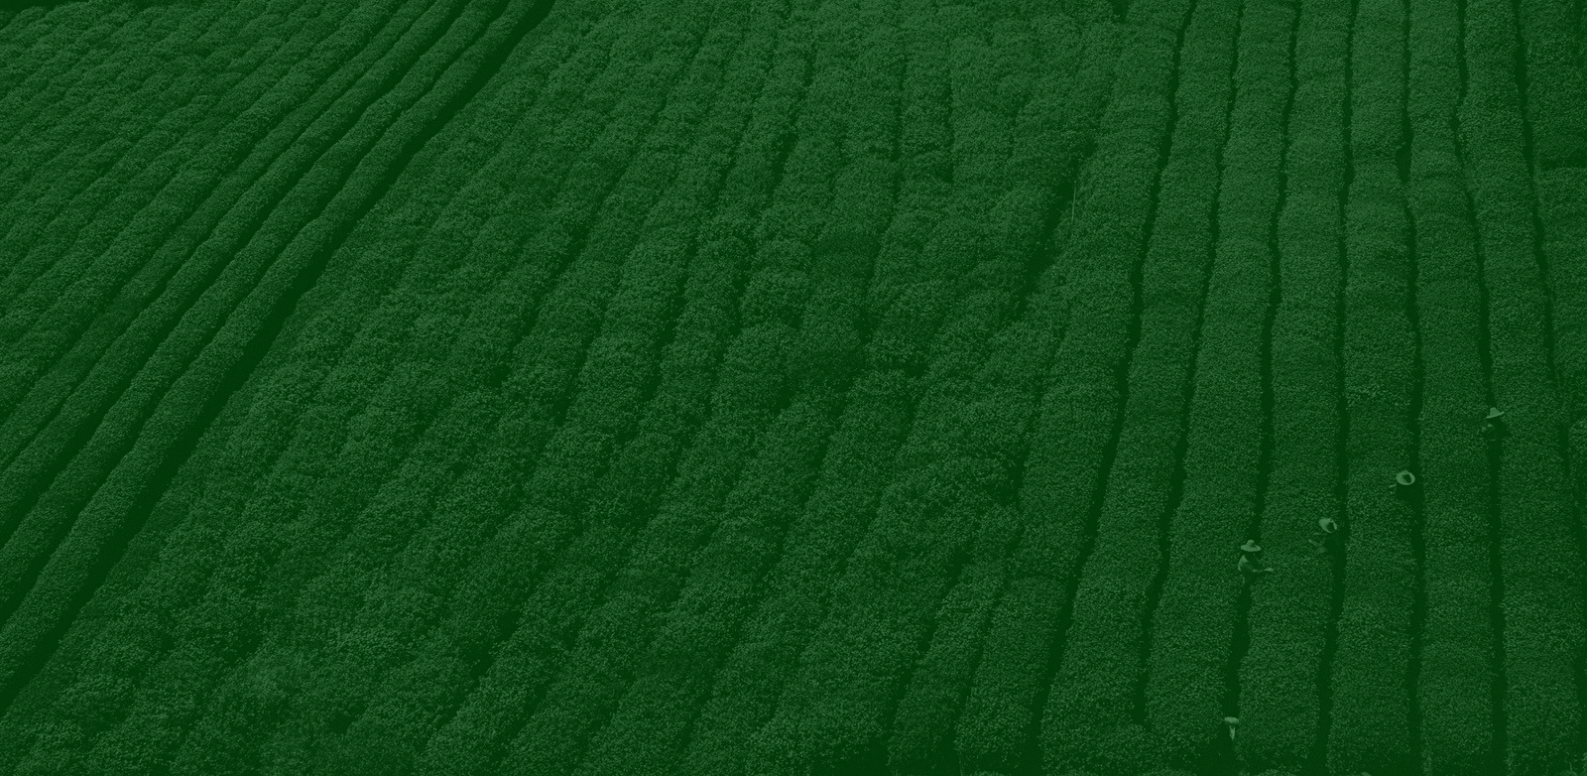

An Overview of IoT Applications In Agriculture with Two Case Studies Done Locally In Iran
Professor: Mohammad Hossein Bateni
Presented by: Mahdi Shirazi

Slide 2

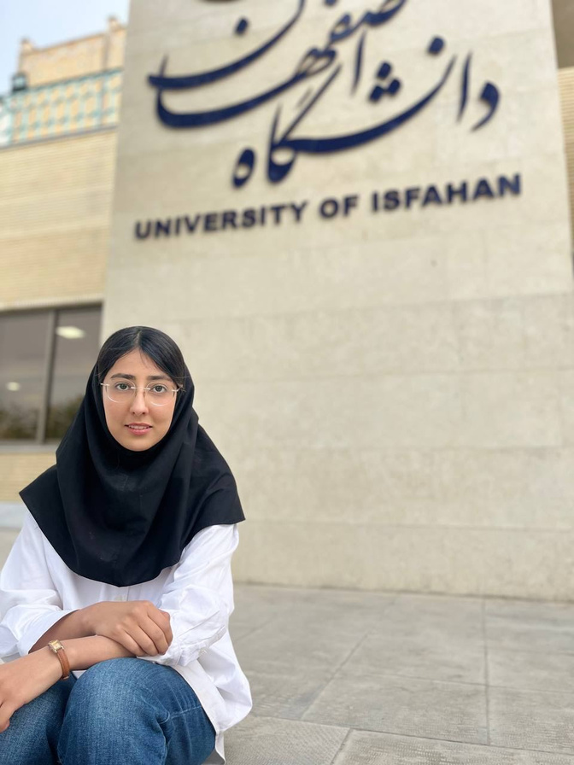

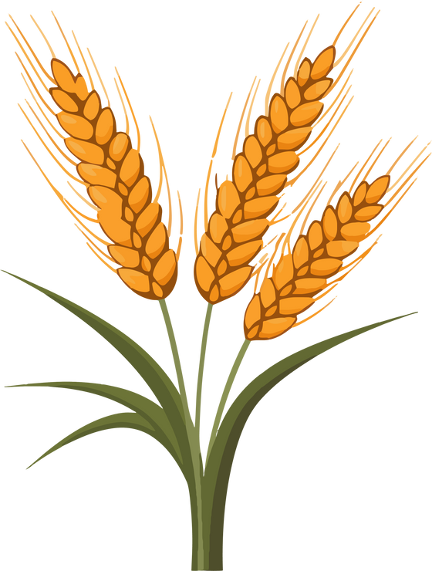

Group Members
Mahdi Shirazi
Kiana Mahdian
Yasmin Torki

Slide 3
Introduction
Core Technologies and Architecture of IoT
IoT and Enabling Technologies in Precision Agriculture
IoT Applications In Agriculture
Case Study 1
Case Study 2
Conclusion
Discussion Structure
Topics we will tackle

Slide 4
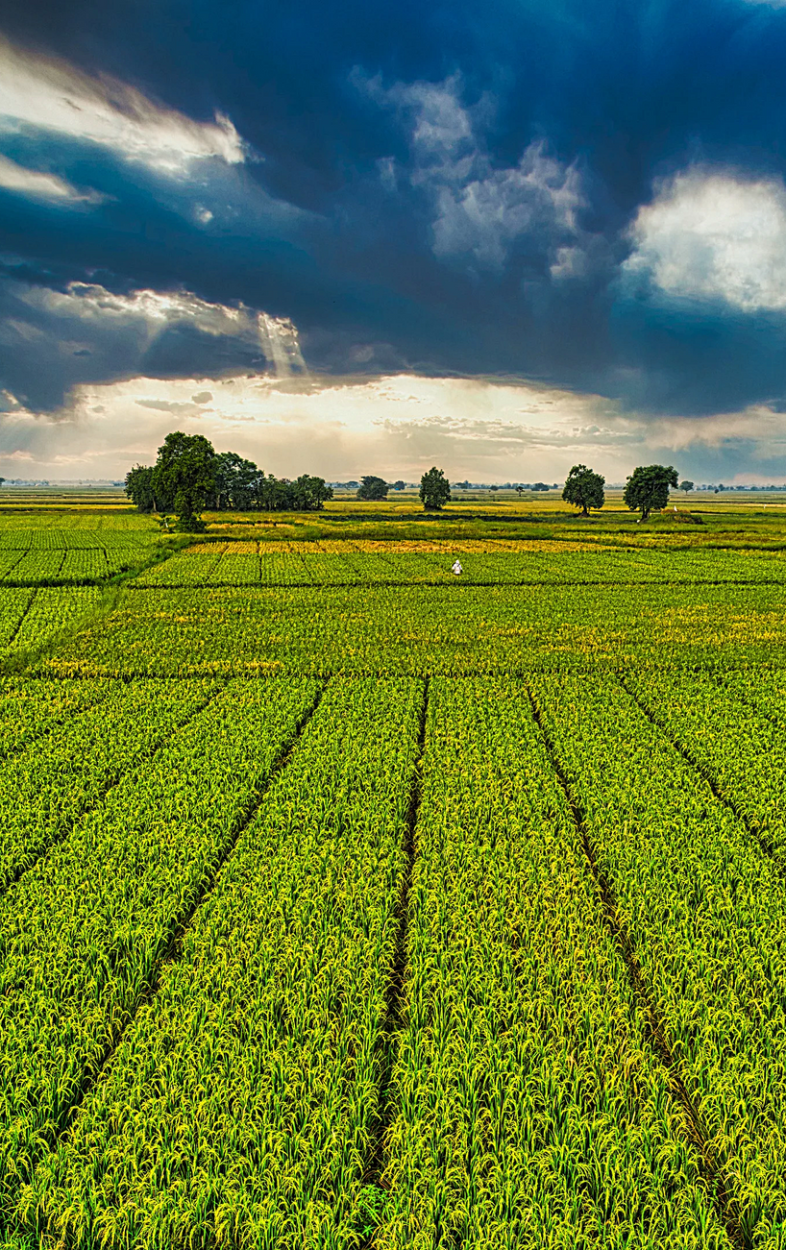
4/32
Introduction
The Internet of Things (IoT) represents a significant technological advancement that interconnects everyday objects through the Internet, enabling them to send and receive data.
Precision agriculture leverages IoT to optimize agricultural practices by using data from various sensors to monitor and manage environmental conditions, machinery, and irrigation systems.
Two studies done in coordination to Iran’s agriculture are discussed.

Slide 5
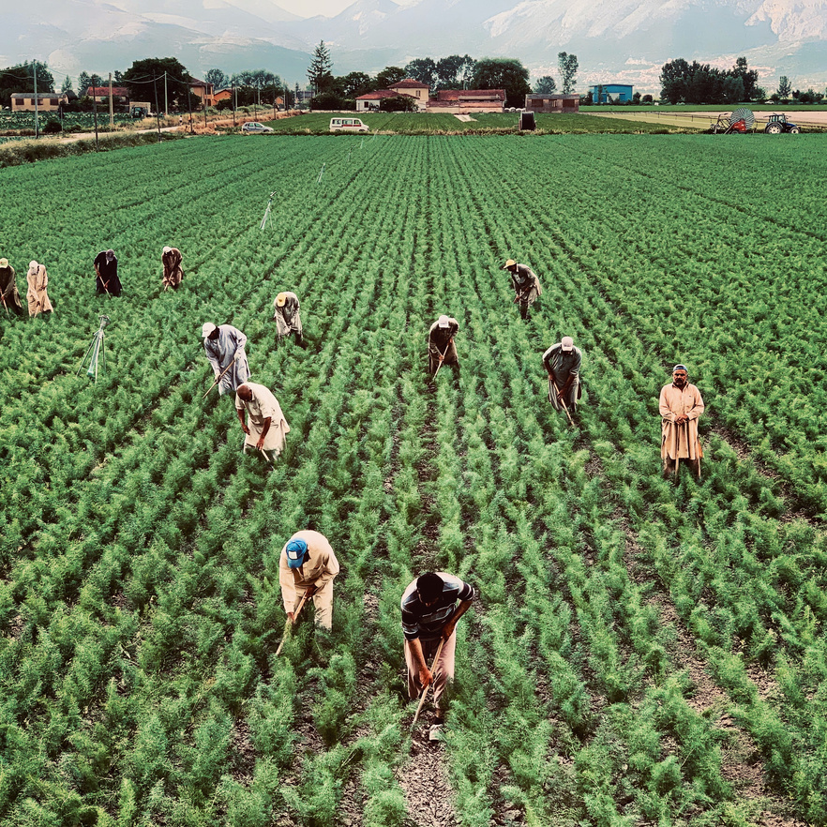
Core Technologies and Architecture of IoT
5/32
IoT refers to a network of interconnected objects with sensors enabling internet connectivity.
Three-Layer IoT Architecture based on IEEE P2413 standard:
Application Layer: Interfaces with end users and applications.
Networking and Communication Layer: Handles connectivity and data transmission.
Sensing Layer: Collects data through various sensors.

Slide 6
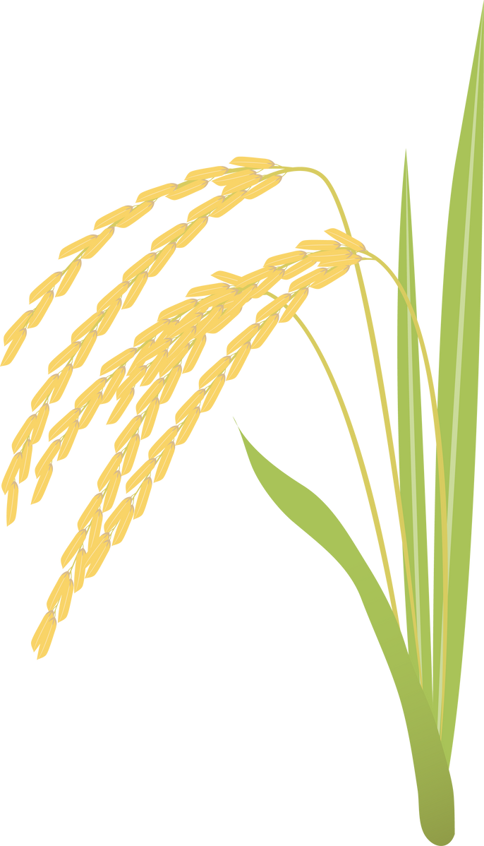
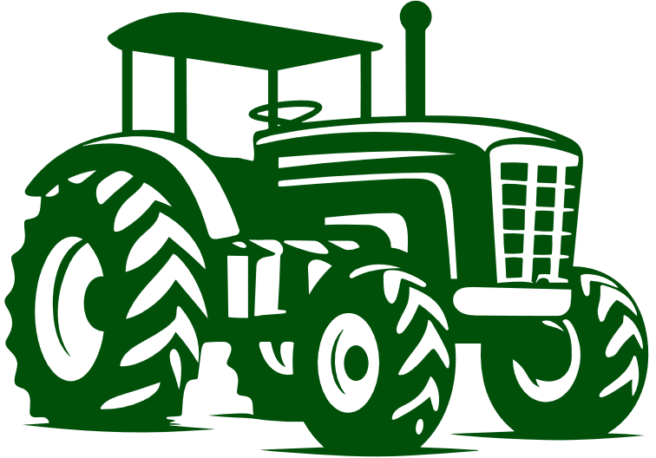
6/32
Key IoT Technologies
RFID: Uses radio waves to transmit data from mobile entities to readers.
Identification Technologies: EPC and uCode for recognizing and addressing devices.
Addressing Methods: IPv6 and 6loWPAN-IPv4 for connectivity.
Communication Technologies: WiFi, ZigBee, Bluetooth, LTE, and 5G.

Slide 7

7/32
IoT and Enabling Technologies in Precision Agriculture
IoT Hardware Platforms
Growth Drivers: Small, inexpensive microcontrollers and computing hardware.
Components: Processors, wireless chips, memory, and more.
Arduino Mega
Arduino Uno
Arduino Yun Beaglebone Black
Raspberry Pi3 (B model)
Intel Galileo

Slide 8

8/32
The IoT cloud platforms in the context of agriculture
Major Providers: AWS IoT, Microsoft Azure IoT Hub, IBM Watson IoT, Google Cloud, Salesforce IoT.
Benefits: Scalability, affordability, extensive reach.
Usage: Monitoring, control systems, data analysis, and planning.

Slide 9
9/32
Machine To Machine (M2M) communications in agriculture and Agricultural Smartphone Apps
Definition: Automated exchange of information between devices with minimal human intervention.
Technologies: IP, WiFi, SMS, Zigbee.
Applications: Connecting agricultural machinery and vehicles, remote monitoring.
Popular Apps: Sirrus, Manure Monitor, Agrivi, TractorPal.

Slide 10
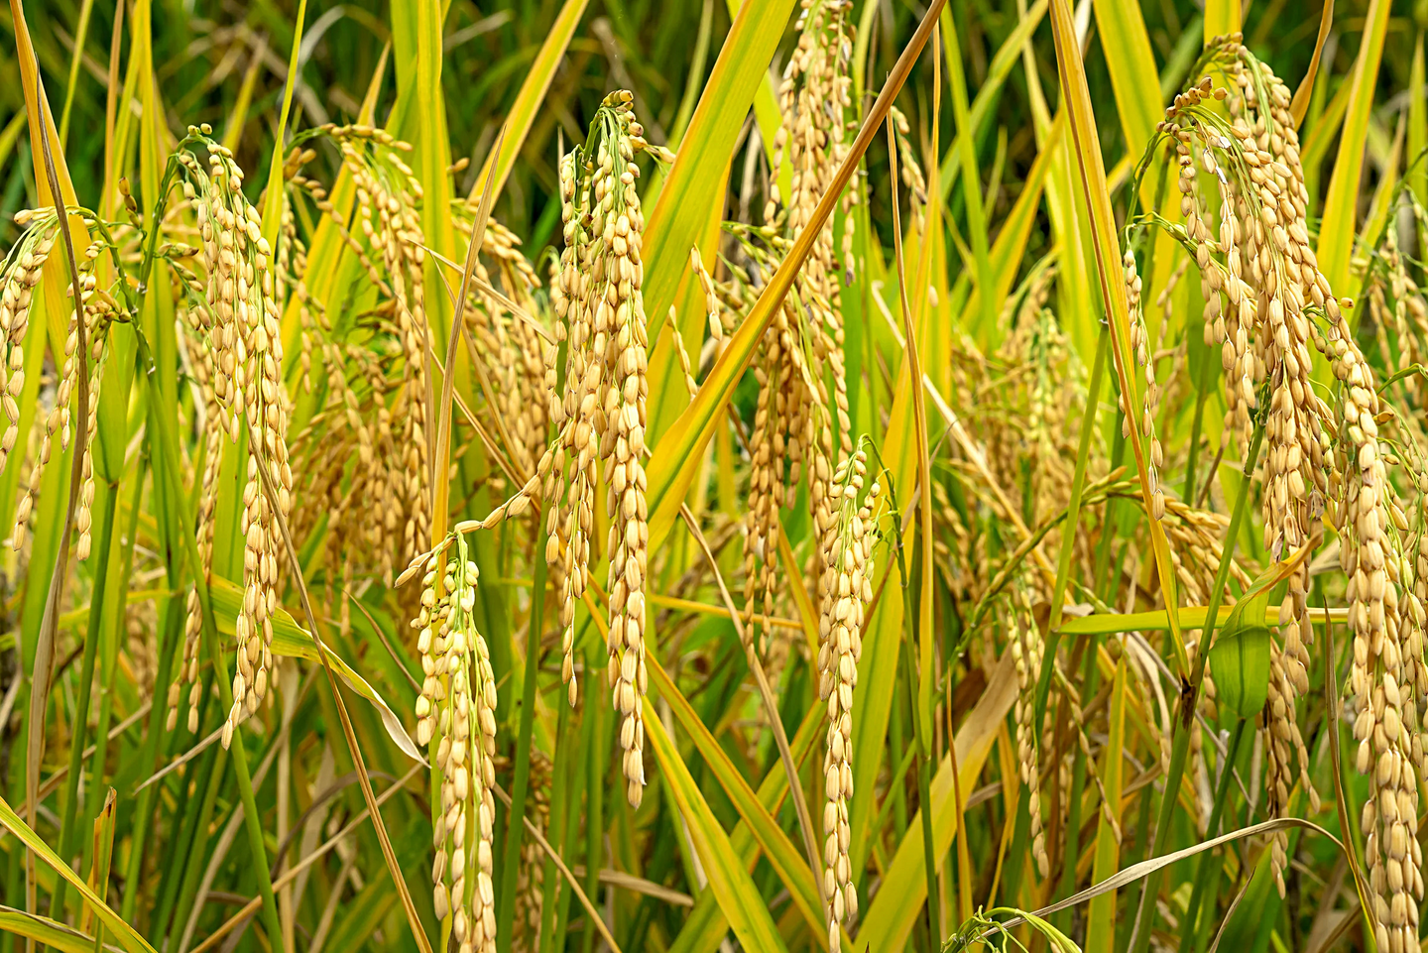
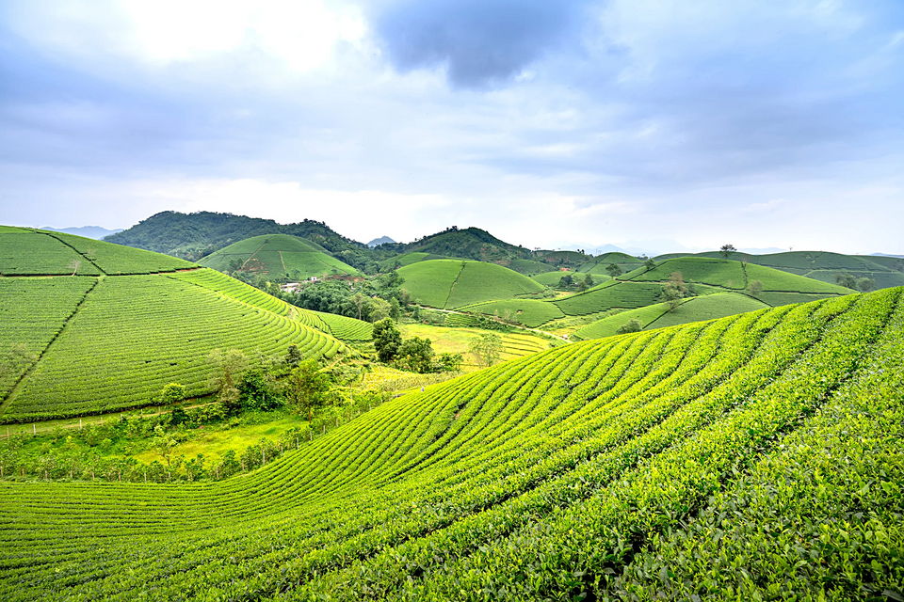
Internet of Things applications in agriculture
10/32
Precision Agriculture (PA) Overview
A modern management approach using advanced technologies to enhance farming efficiency and productivity.
Key Technologies in PA:
Information Technology (IT)
Geographic Information Systems (GIS)
Global Positioning Systems (GPS)
Wireless Sensor Networks (WSN)
Data Collection Techniques
Objectives of PA:
Increase Crop Yields: Optimize inputs and farming practices.
Minimize Environmental Impact: Reduce waste, conserve resources, and promote sustainability.

Slide 11

11/32
Environmental Monitoring and Control
Wireless Sensor Networks (WSNs): Scalability, fault tolerance, energy efficiency, effective monitoring systems.
Key Parameters: WSN’s sensor nodes can measure and process several environmental parameters e.g. soil moisture, temperature, humidity, water pH, wind speed
Advancements: Greenhouse monitoring, automated controls, data analysis via cloud.

Slide 12
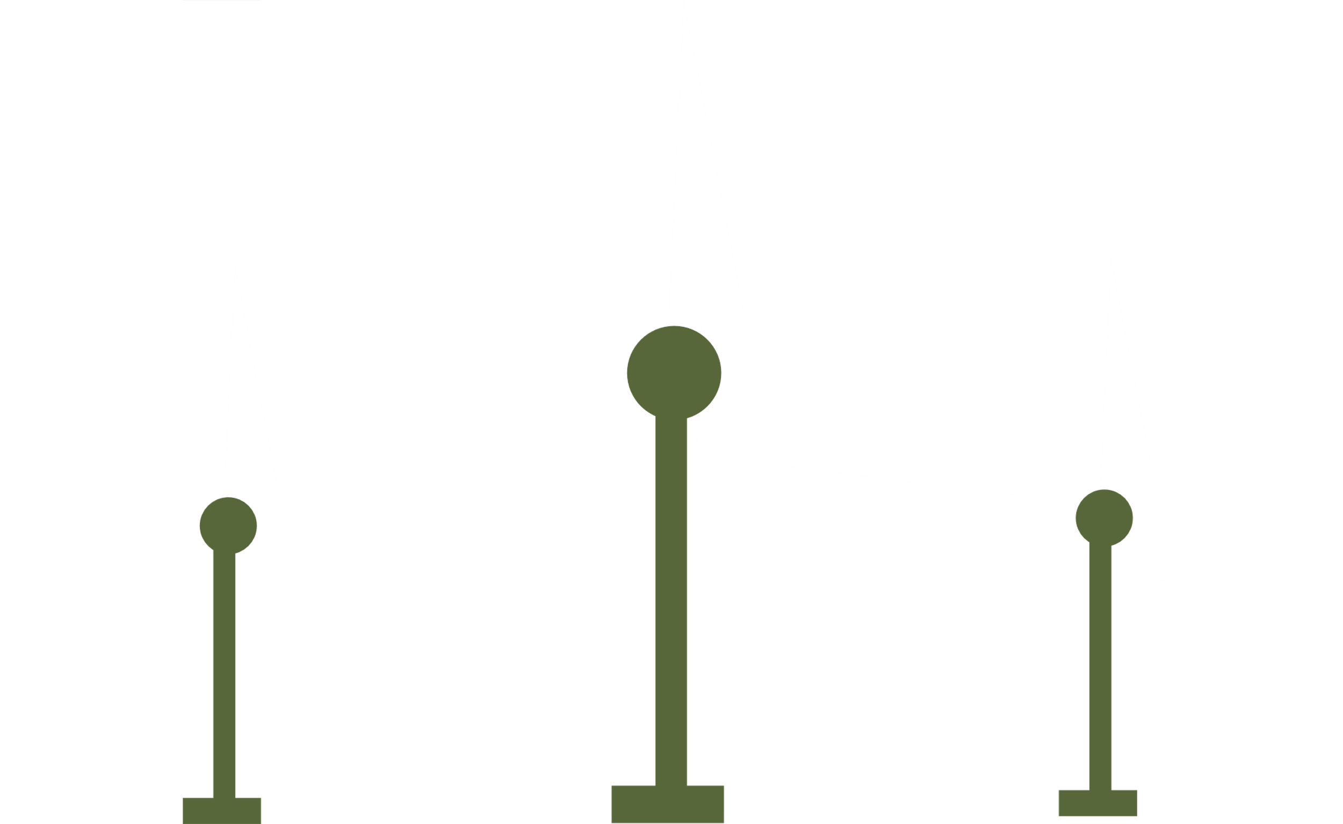
12/32
Ecological Monitoring
Challenges: Environmental pollution, climate change, biological alterations.
EIoT: Sensing, collecting, preprocessing, transmitting environmental data.
Benefits: Continuous, real-time monitoring.

Slide 13

13/32
Smart Irrigation Systems
Water Demand: Agriculture accounts for 70% of global water consumption.
Modern Systems: Networked sensors, microcontrollers, actuators.
Implementation: Soil moisture sensors, data analysis, automated irrigation.

Slide 14

Predicting the Impact of Internet of Things on the Value Added for the Agriculture Sector in Iran Using Mathematical Methods
Case Study 1

Slide 15
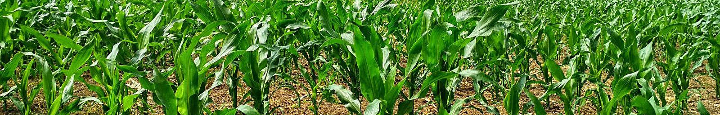
15/32
Introduction
Context: Iran faces significant water shortages, exacerbated by climate change, inefficient management, and excessive consumption.
Objective: To investigate the economic impact of implementing IoT technology, specifically smart irrigation, in Iran's agriculture sector.

Slide 16
16/32
Background on Iran's Agriculture
Water Resources: Iran has limited freshwater resources, with 92.2% used in agriculture.
Agricultural Efficiency: Iran's agricultural productivity is low compared to similar climates.
Internet of Things (IoT) in Agriculture
IoT Definition: IoT consists of interconnected devices that communicate and collect data to optimize operations.
Application: In agriculture, IoT is used for smart irrigation, machinery control, and livestock tracking.

Slide 17
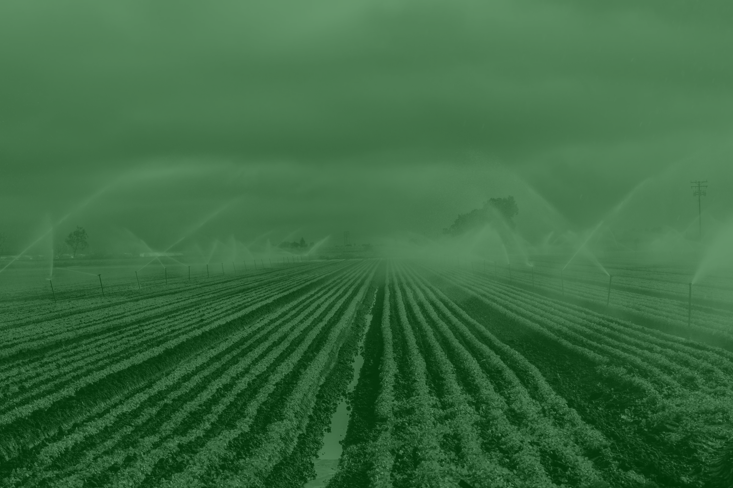

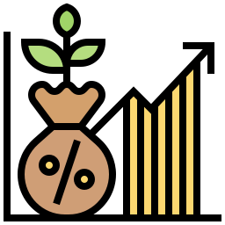

Smart Irrigation System
17/32
Technology: Utilizes Wireless Sensor Networks (WSNs) to monitor soil moisture, temperature, and weather conditions.
20-40%
20%
Reduction of water consumption
Increases agricultural yields

Slide 18
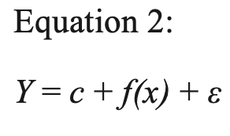
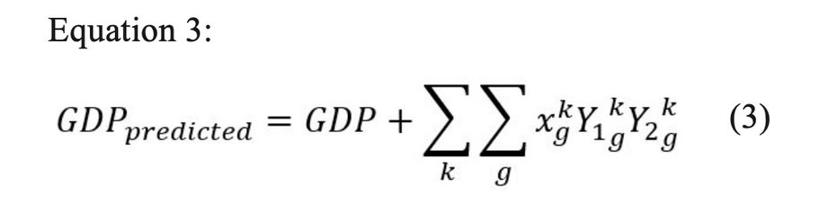
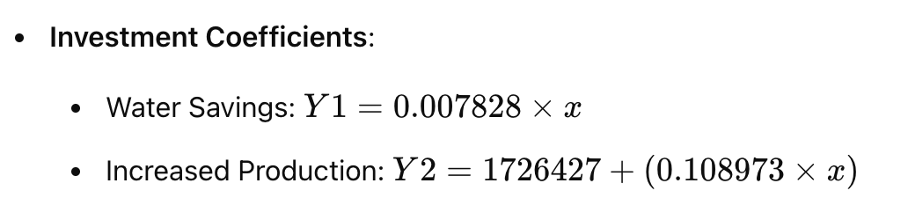
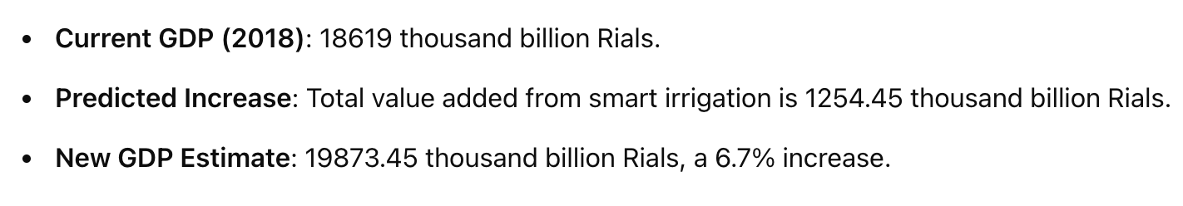
Economic Impact on GDP
18/32

Slide 19
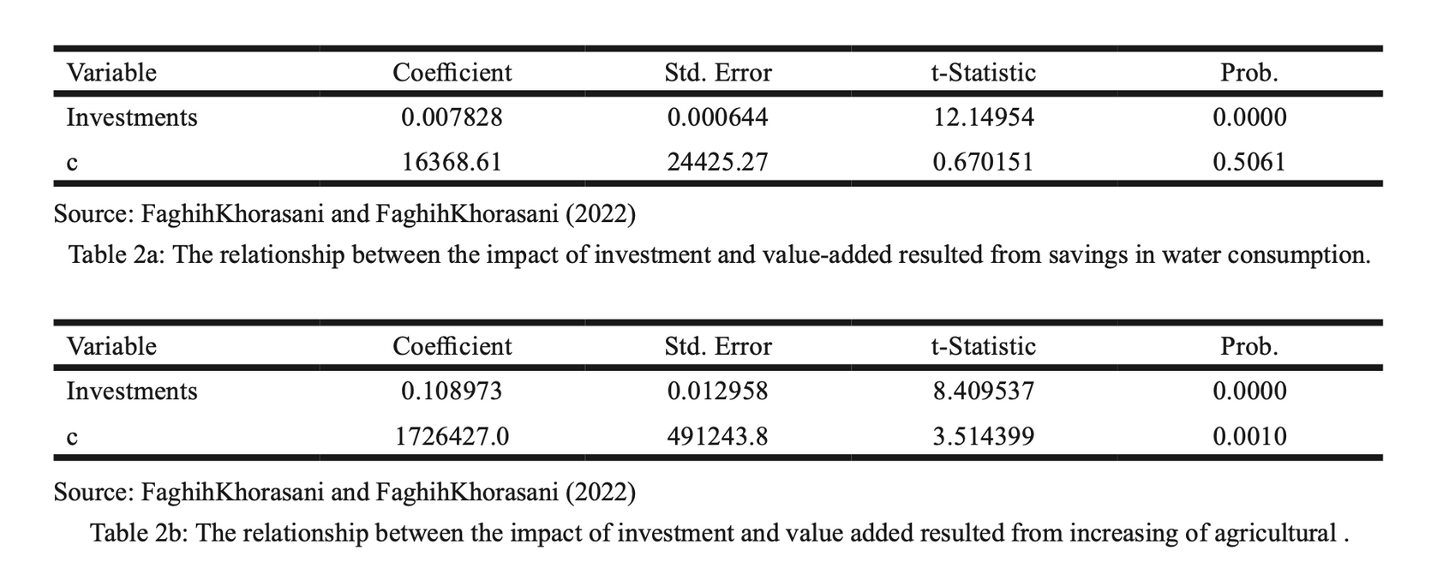
19/32
Economic Impact on GDP
Table 2a and 2b

Slide 20
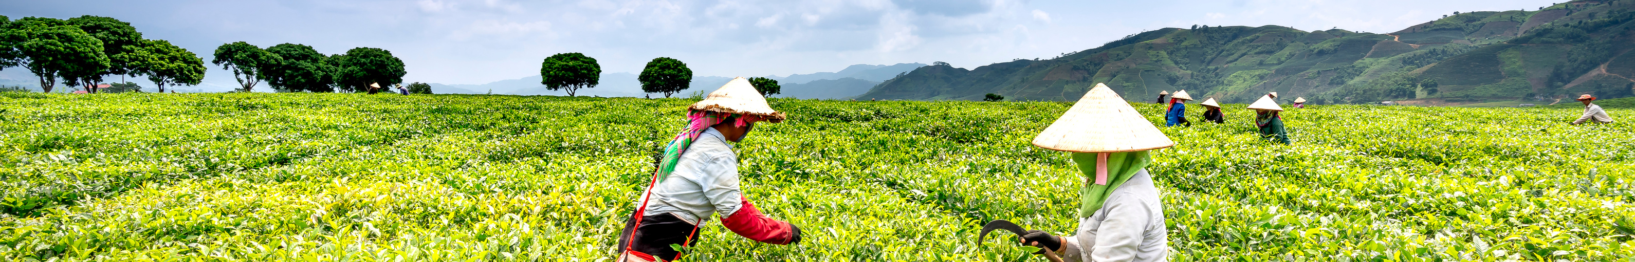
20/32
Results and Discussion
Implementation Cost: Approximately 1.05 billion Rials per hectare.
Annual Costs: Calculated using investment data from pilot projects.
Economic Benefits: Significant GDP growth due to improved agricultural efficiency and water savings.

Slide 21
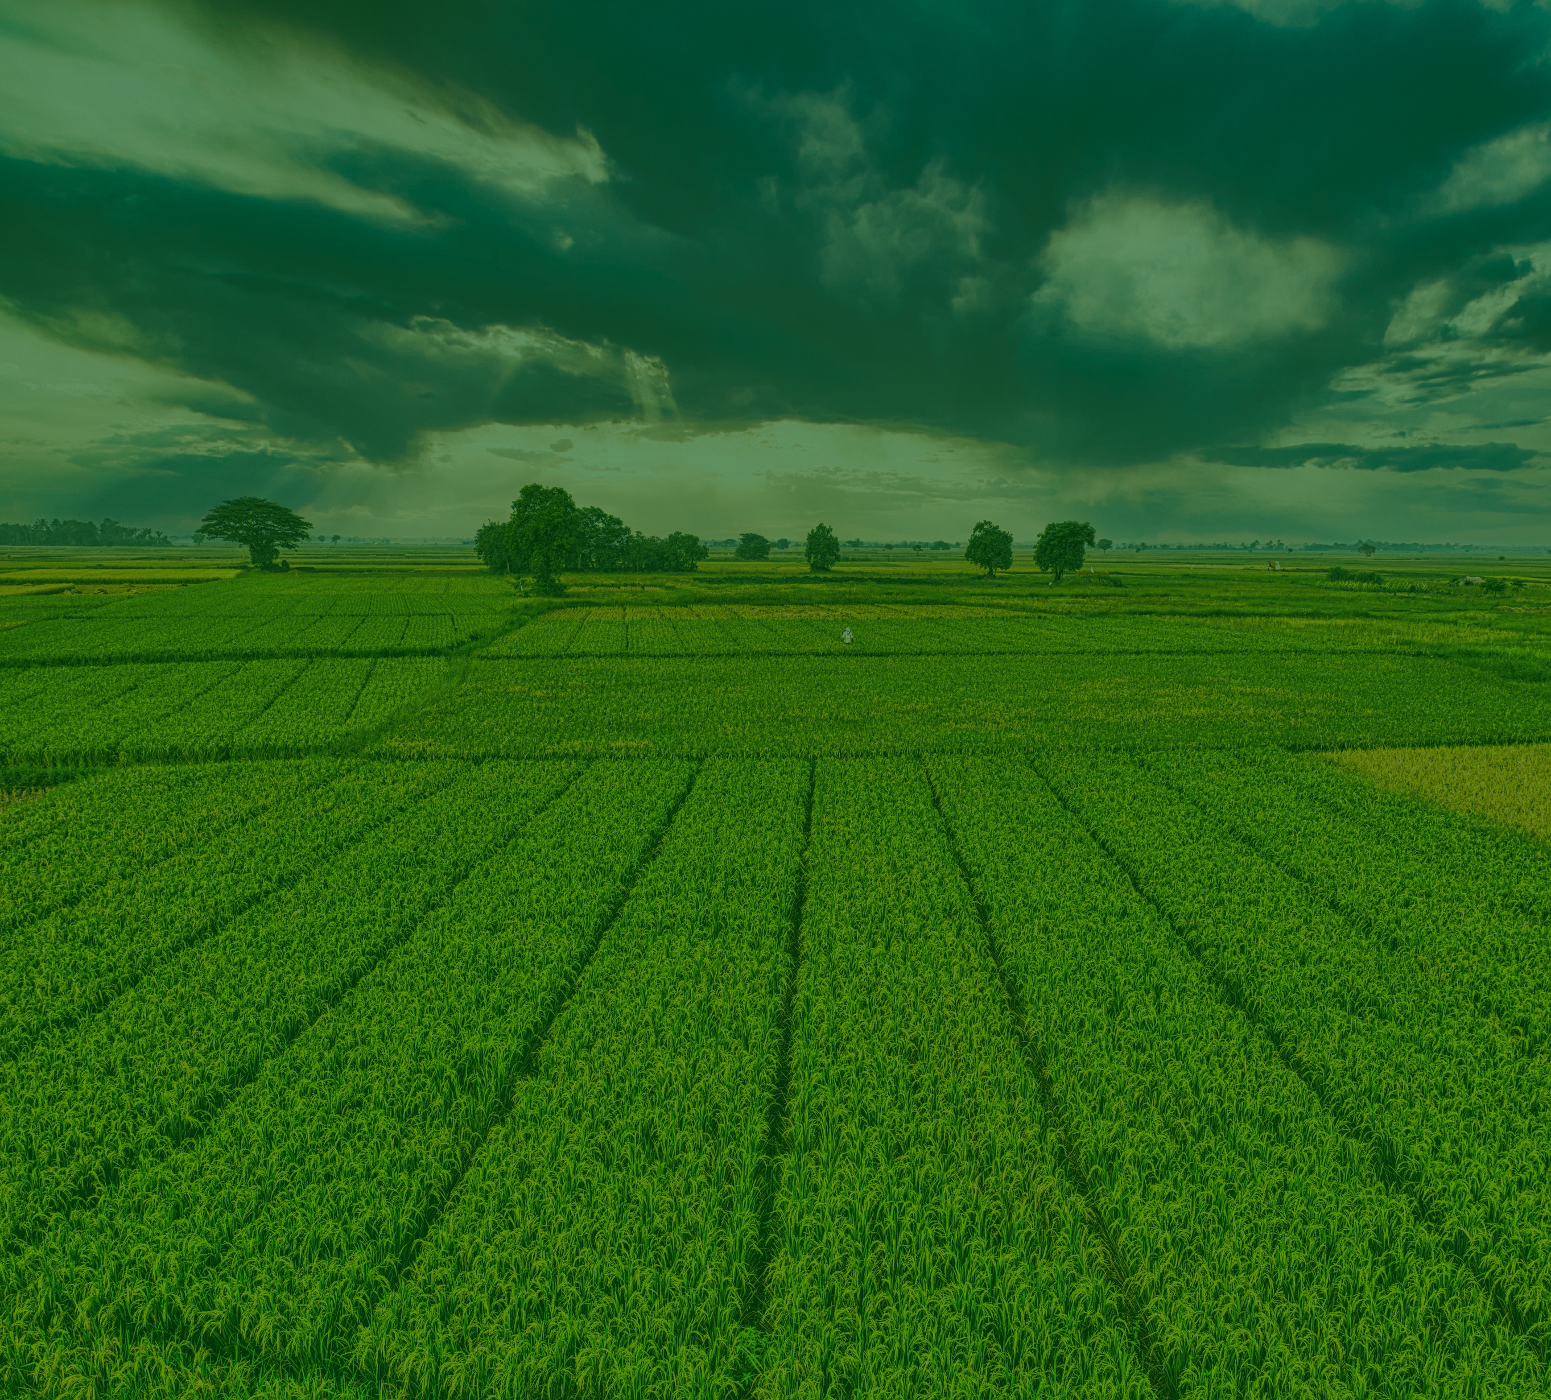

conclusion
21/32
Potential for Economic Growth: IoT implementation in agriculture can lead to substantial economic benefits.
Sustainable Water Use: Smart irrigation helps achieve sustainable water management.
Recommendation: Promoting IoT adoption in agriculture to enhance productivity and economic stability.

Slide 22
Evaluating the Possibility of Using the Power of the Received Signal to Estimate Soil Moisture
Case Study 2

Slide 23
23/32
Paper Name: “Evaluating the Possibility of Using the Power of the Received Signal to Estimate Soil Moisture in Outdoor and Indoor Environments” (Original Name Is In Persian)
Three researchers from the Persian Gulf University have proposed a scientific approach based on Internet of Things (IoT) technology for measuring soil moisture.
The results indicate that with proper processing of the received signal strength indicator (RSSI), it is possible to estimate soil moisture in agriculture with acceptable accuracy.
This and the method proposed could lead to a massive reduction in expenses of implementing a system to control soil moisture in order to achieve excellent irrigation.

Slide 24

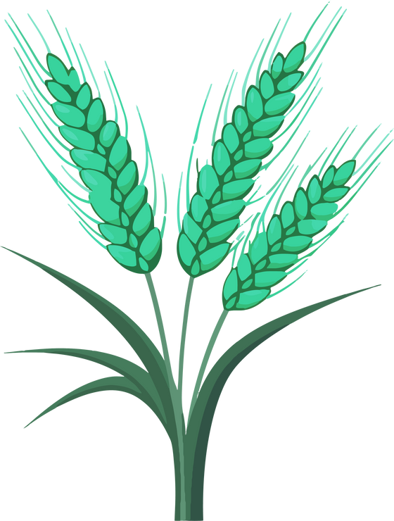

24/32
Soil Moisture Measurement Challenges
Financial
Large Farms
Power Supply

Slide 25
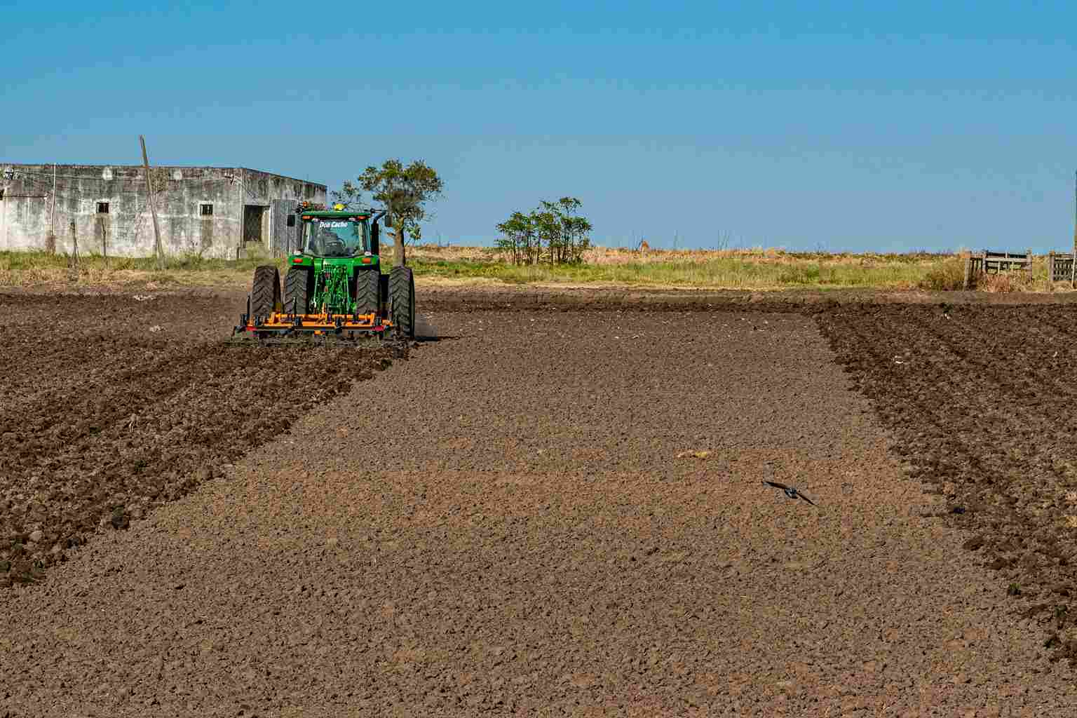
25/32
Experiment Methodology
Materials:
a Lora module
a soil moisture sensor
The experiment was conducted in both indoor (inside a building) and outdoor (on the campus of Persian Gulf University) environments..

Slide 26
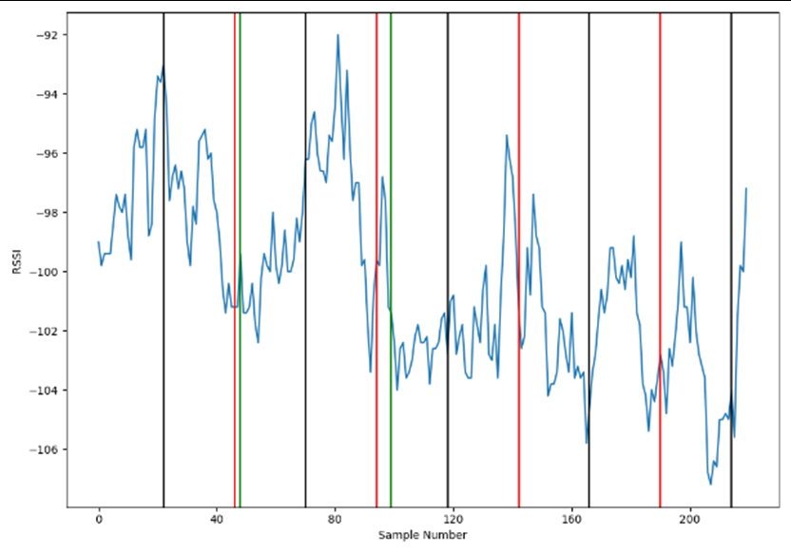
26/32
Results and Discussion
RSSI over time for indoor environment
Indoor Environment

Slide 27
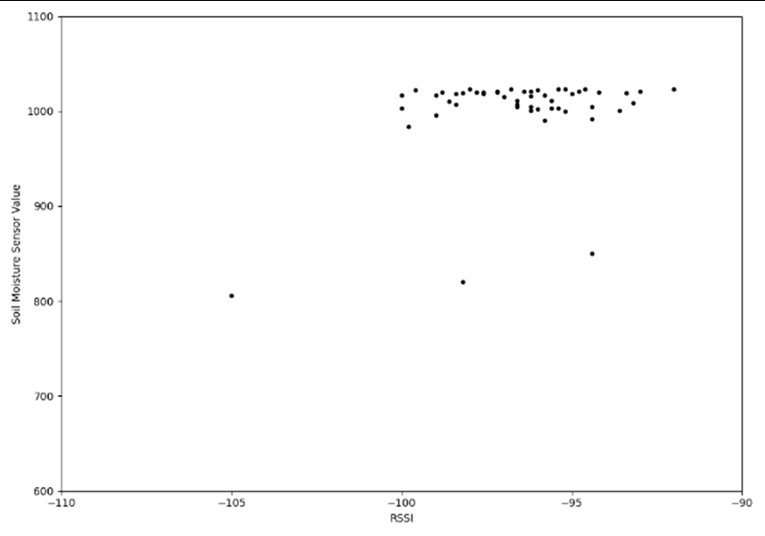
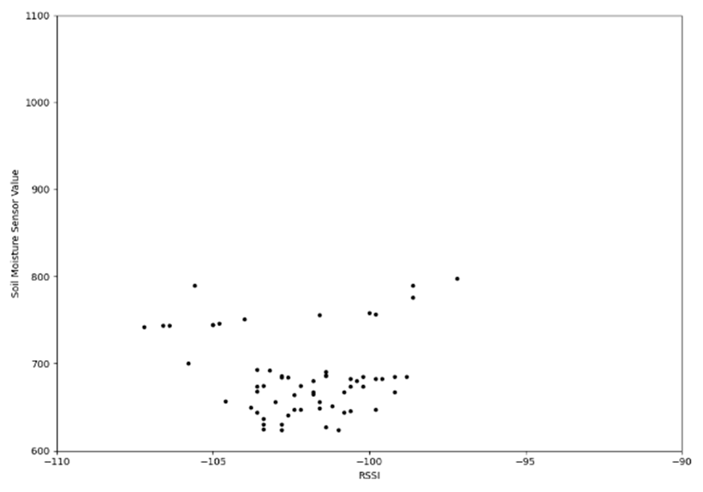
27/32
Results and Discussion
Indoor Environment
Soil moisture versus RSSI scattering for dry soil at night
Soil moisture versus RSSI scattering for wet soil at night

Slide 28
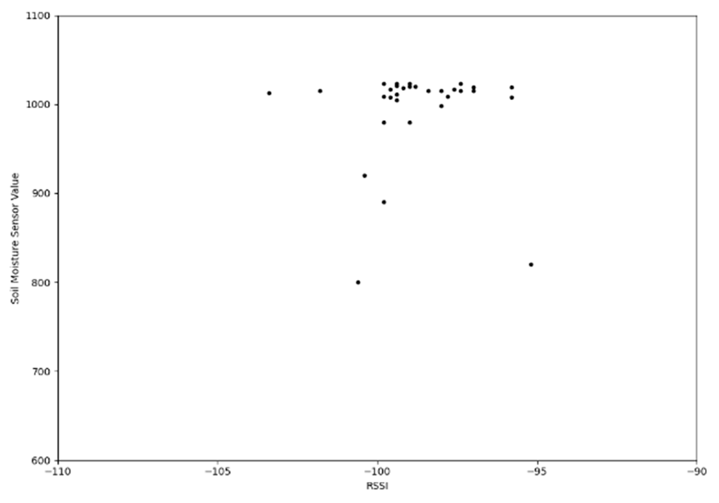
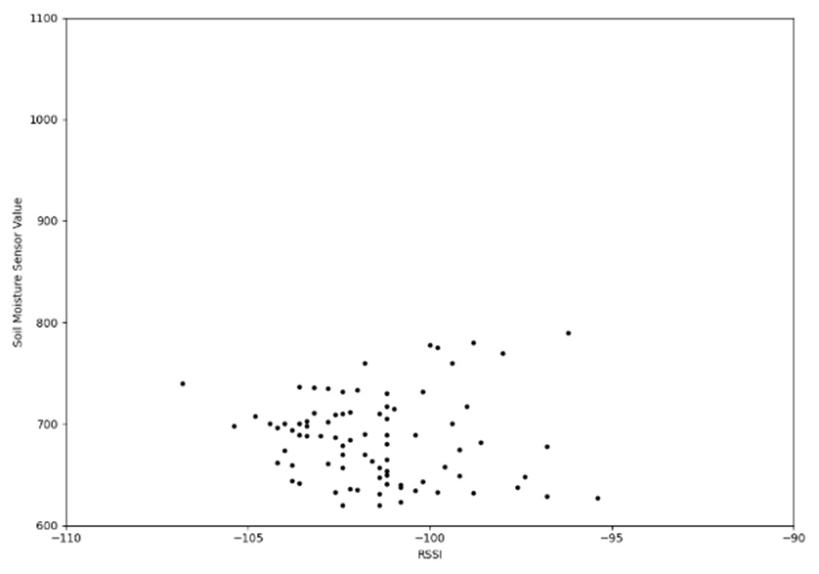
28/32
Results and Discussion
Indoor Environment
Soil moisture versus RSSI scattering for dry soil at daylight
Soil moisture versus RSSI scattering for wet soil at daylight

Slide 29
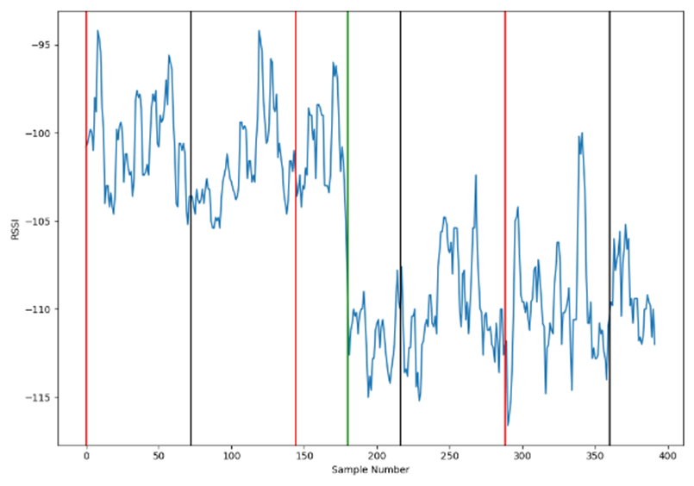
29/32
Results and Discussion
RSSI over time for outdoor environment
Outdoor Environment

Slide 30
30/32
Conclusion
Ultimately, this research concludes that the relationship between RSSI and soil moisture is significant enough to consider it as an acceptable criterion for measuring and estimating soil moisture in smart agriculture at a much lower cost than similar methods.

Slide 31
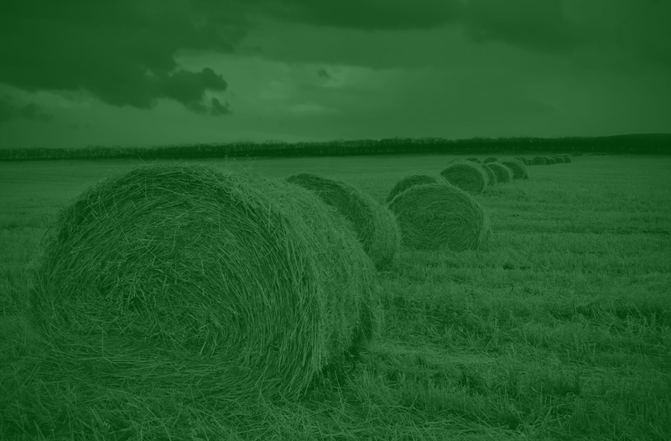


31/32
Email address
kianamahdian2002@gmail.com
yasmiintte@gmail.com
mahdielmaximo@gmail.com
Contact Us
Telegram
@kiacola
@yethereweare
@yacmin

Slide 32
32/32
Resources
Abbasi M. & Yaghmaee M. (2019). “Internet of Things In Agriculture: A Survey” University of Isfahan IoT Conference (2019)
FaghihKhorasani H. & FaghihKhorasani A (2022). “Predicting the Impact of the Internet of Things on the Value Added for the Agriculture Sector In Iran Using Mathematical Methods” AGRIS on-line Papers in Economics and Informatics
Dokard A., Keshavarz A. & Mansorinejad M. (2023). "Evaluating the Possibility of Using the Power of the Received Signal to Estimate Soil Moisture in Outdoor and Indoor Environments" University of Isfahan IoT Conference (Fall of 2023)

Slide 33
4/32
Thank You!

